Slide 1
Loan Approval Prediction Dataset
Exploratory Data Analysis: Data Storytelling

Slide 2
What is loan?
A loan is the transfer of money by one party to another with an agreement to pay it back.
The recipient, or borrower, incurs a debt and is usually required to pay interest for the use of the money.
How it works?
Apply for a loan from a bank, corporation, government, or other entity.
The borrower is required to provide specific details such as the reason for the loan, their financial history, Social Security number (SSN), and other information.

Slide 3
Goal:
To analyze the loan approval dataset to discover insights about how the loan has been approved.
Contd..
Lender reviews this information as well as a person's debt-to-income (DTI) ratio to determine if the loan can be paid back.
Based on the applicant's creditworthiness, the lender either denies or approves the application.
Proposal:
Use data cleaning, EDA, data visualization and statistics techniques to analyze the loan approval insights, and build a machine learning model.

Slide 4
About dataset:
The loan approval dataset is a collection of financial records.
Contains information used to determine the eligibility of individuals or organizations for obtaining loans from a lending institution.
Includes various factors such as credit score, income, employment status, loan term, loan amount, assets value, and loan status.
Commonly used dataset in machine learning and data analysis to develop models and algorithms that predict the likelihood of loan approval based on the given features.

Slide 5
About columns:
loan_id
no_of_dependents: Number of Dependents of the Applicant
education: Education of the Applicant (Graduate/Not Graduate)
self_employed: Employment Status of the Applicant
income_annum: Annual Income of the Applicant
loan_amount: Loan Amount
loan_term: Loan Term in Years
cibil_score: Credit Score
residential_assets_value
commercial_assets_value
luxury_assets_value
bank_asset_value
loan_status: Loan Approval Status (Approved/Rejected)

Slide 6
Plans:
Can we plot a histogram to find some trends based on different loan amounts, in the approved and rejected loans ?
Does a scatter plot help find the relation between annual income and loan amount?
Also, check whether the credit score has any effect on loan amount and loan status.
Find the correlation scores of 4 assets values and other variables with heatmap.
Find all the features that affect the loan status.
Preprocess the data, then train and predict with models like Logistic regression and Random Forest.
Create confusion matrix and calculate precision, recall, f1-score etc.

Slide 7
By data cleaning scans, analyzed:
This dataset is very clean.
There is no null value and duplicated value in this dataset.
no_of_dependents, education, self_employed and loan_status are categorical columns.
Other columns are numerical.
There are a total 4269 rows in this dataset, with 13 columns (features).
There are 2656 data with an approved loan_status, which is about 62.2% compared to the "rejected" group.

Slide 8
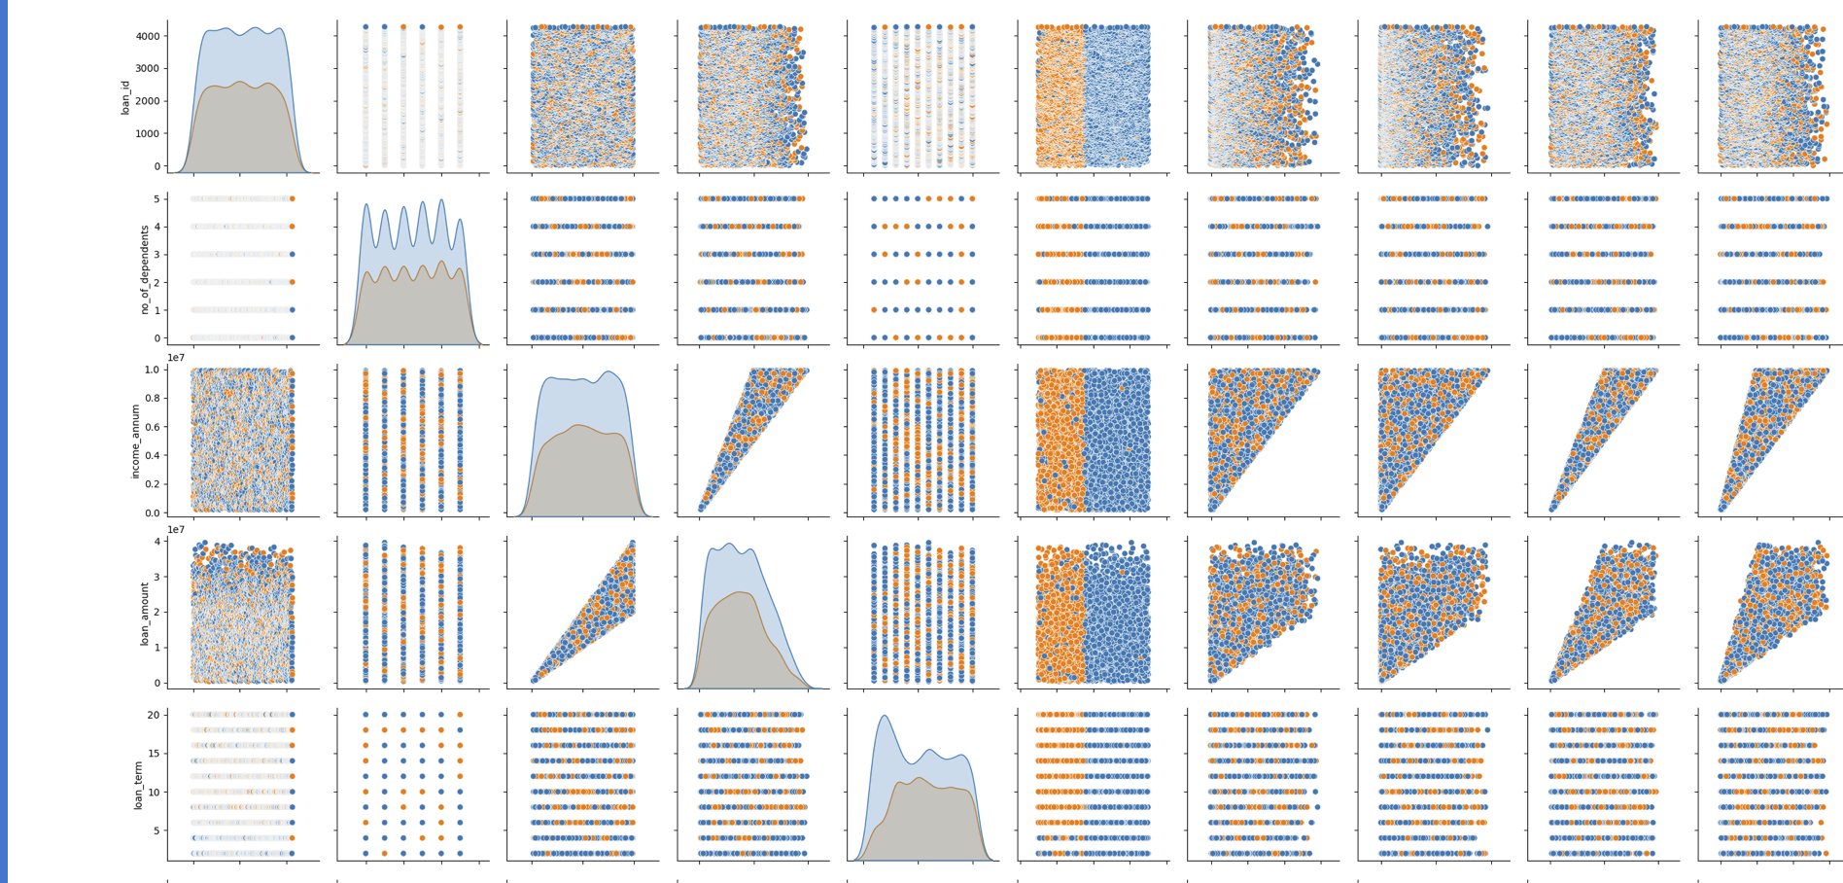
Created a pair plot for numerical columns

Slide 9
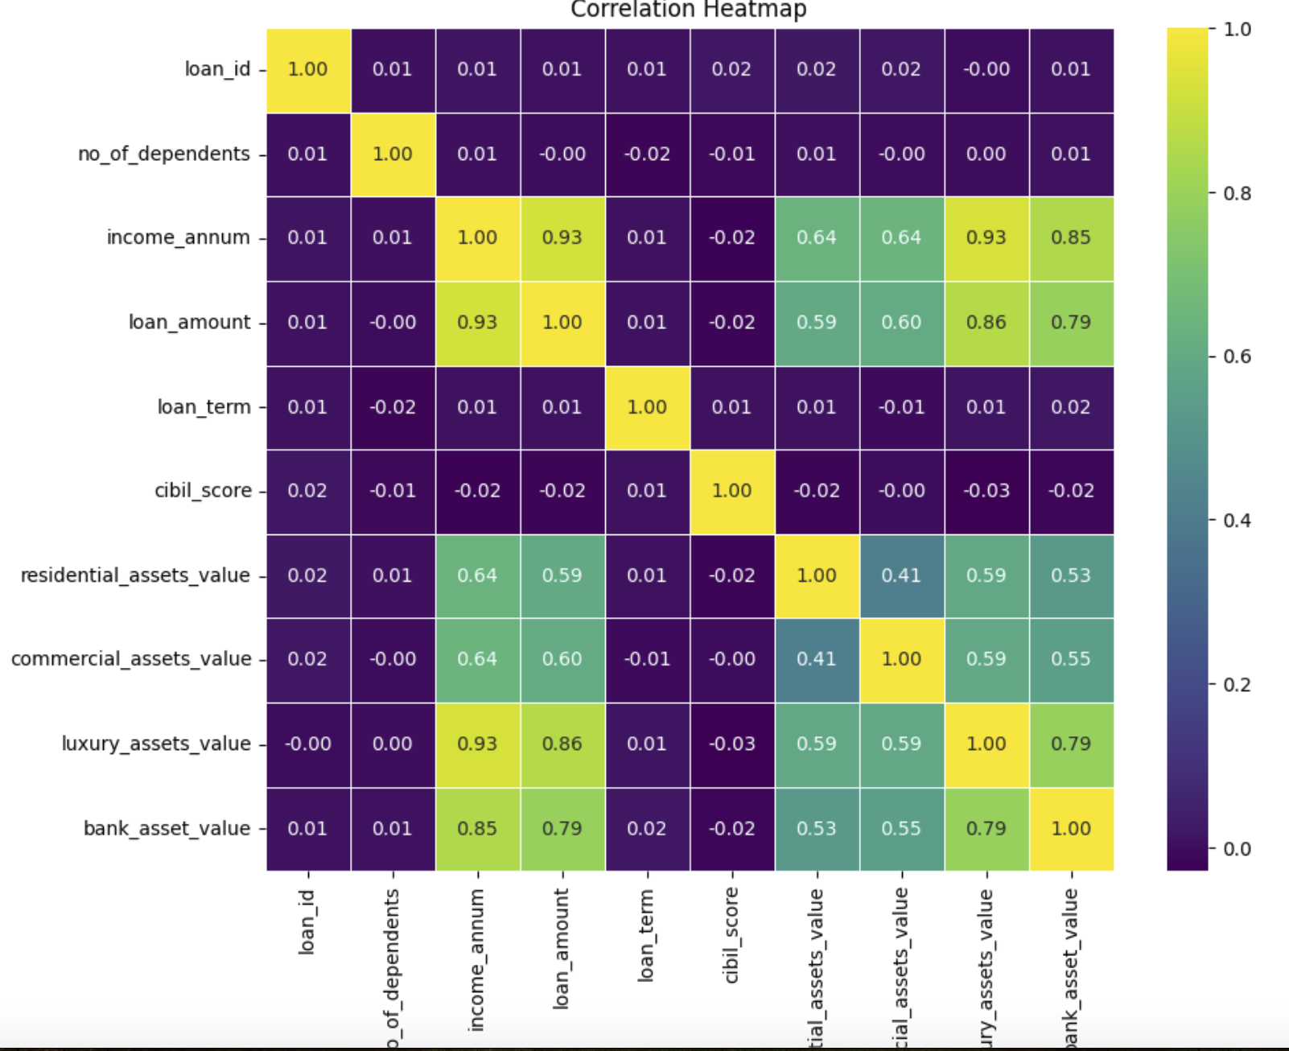
Some variables have positive correlation with other variables.
loan_amount & income_annum, luxury_assets_value & bank_asset_value, income_annum & luxury_assets_value, loan_amount & luxury_assets_value, income_annum & bank_asset_value.
Heat Map

Slide 10
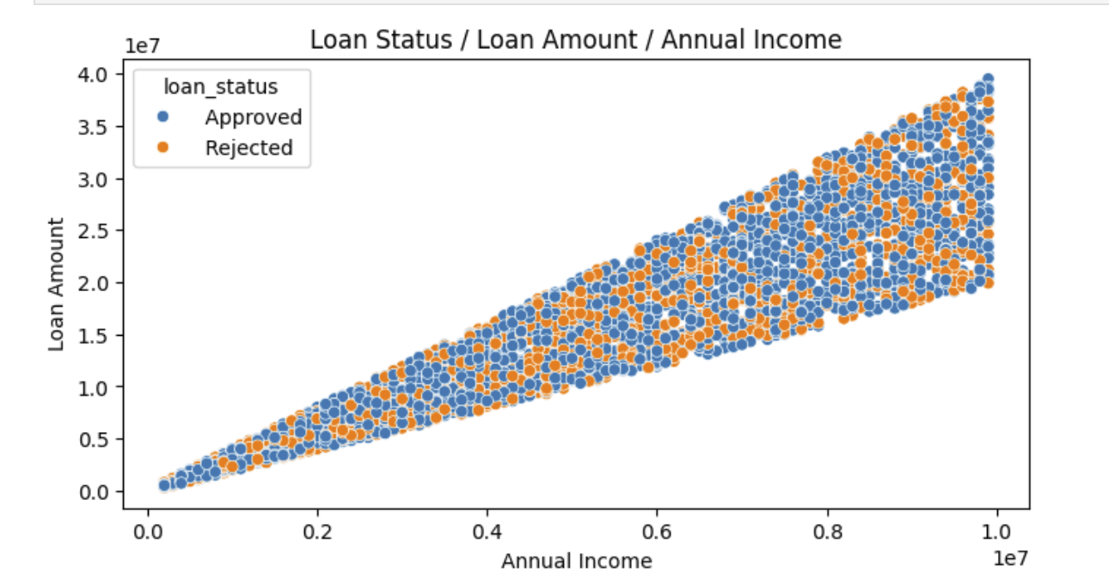
When annual income increases, the loan amount tends to increase.
The applicants who have the lower annual income have a narrow range in loan amounts.
The applicants who have the higher annual income have a wider range in the loan amounts.
The applicants who have the highest annual income have chances of being rejected when they apply lower loan amount.
Plot of loan_amount & income_annum

Slide 11
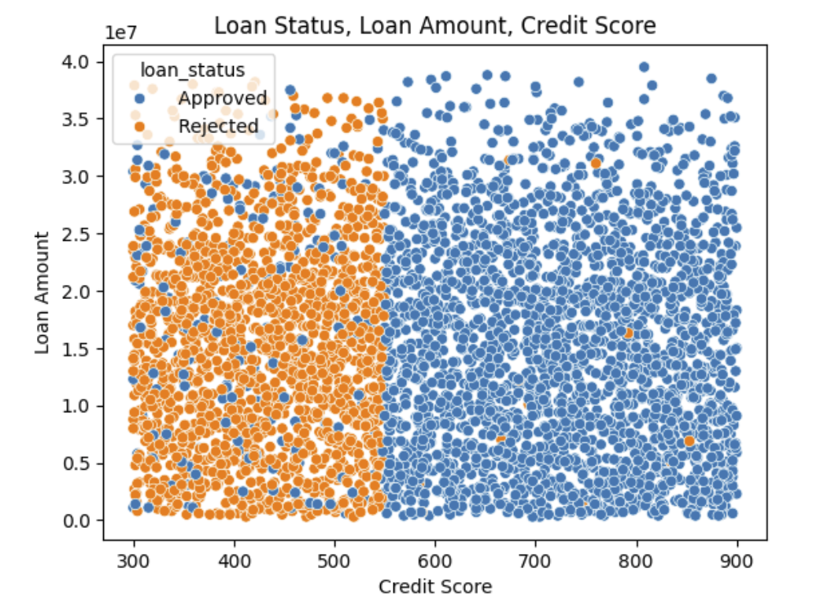
According to Equifax, the standard of the credit scores are: 300-579: Poor, 580-669: Fair, 670-739: Good, 740-799: Very good.
From fig, the loan status is highly related to the credit score.
The credit score that separates the loan status is not 579 which is the highest score of the "poor" credit score.
i.e., the poor credit scores which are above 540 - 550 still have a good chance of being approved by loan lenders. This could be attributed to lenders' flexibility or specific factors that impact approval decisions.
Few of them above 740 is also rejected.
Credit Score vs Loan Amount

Slide 12
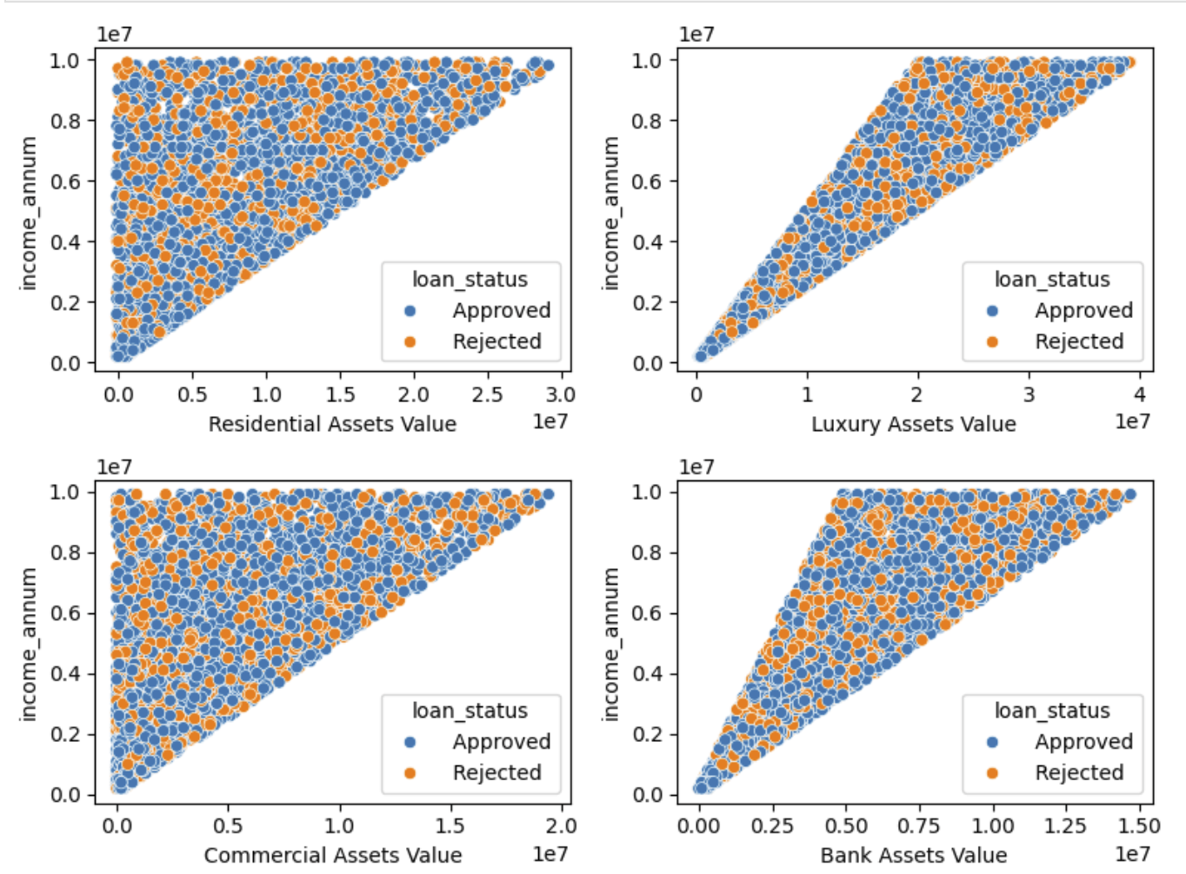
Plotting Luxury Assets, Bank Asset, Residential Assets, Commercial Assets Values
Luxury Assets Value: Total value of high-end or luxury items owned by the individuals or organizations.
These could include items like luxury vehicles, valuable artwork, jewelry, or other premium possessions.
Bank Asset Value: Total value of assets held by the bank or lending institution itself.
It might be cash reserves, investments, and other financial assets.

Slide 13
Contd..
Residential Assets Value: A measure of the total value of residential properties or real estate assets owned by the individuals or organizations in the dataset.
Commercial Assets Value: This could represent the total value of commercial properties or business-related assets owned by the individuals or organizations in the dataset.
Commercial properties might include office buildings, retail spaces, warehouses, and similar assets.
For residential_assets_value and commercial_assets_value, once these asset value reaches a certain point, the annual income tends to increase significantly.
There's a higher variability in annual income for any given luxury assets value.

Slide 14
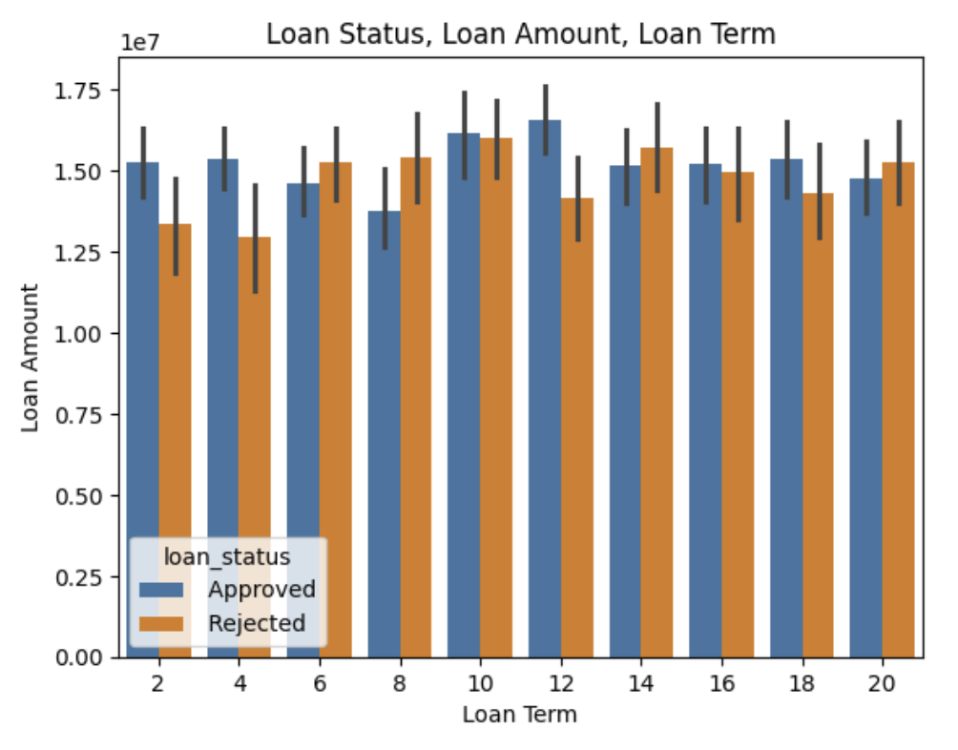
Loan Term vs Loan Amount
The shortest loan term in this dataset is 2 years.
Between 2-4 years gets the one of the most chances for being approved by the lenders.
In 12 years approval is more compared to other loan terms.
When the loan term is in between 4-12 years, and after 12 yrs the chance of being rejected have significantly increased.

Slide 15
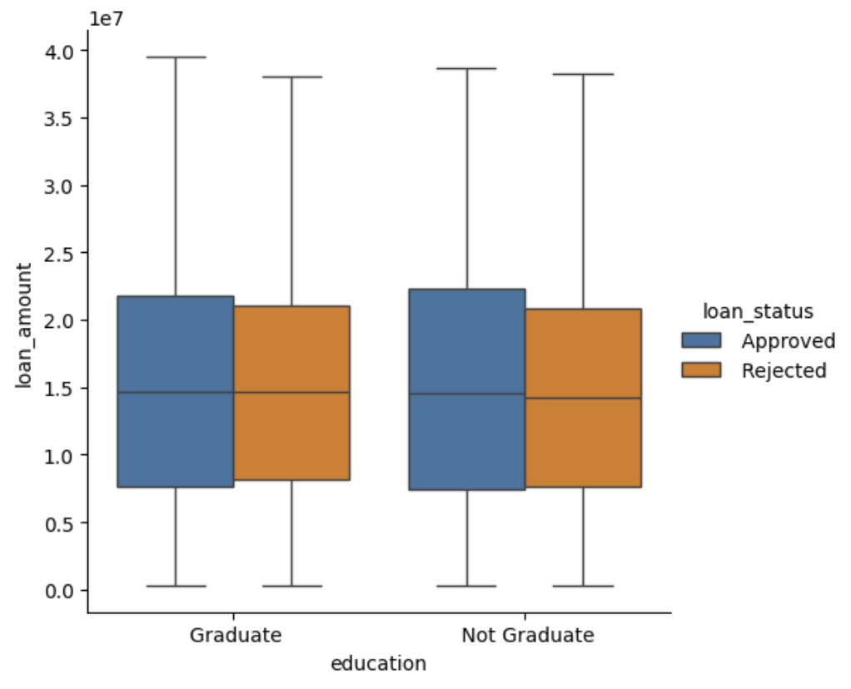
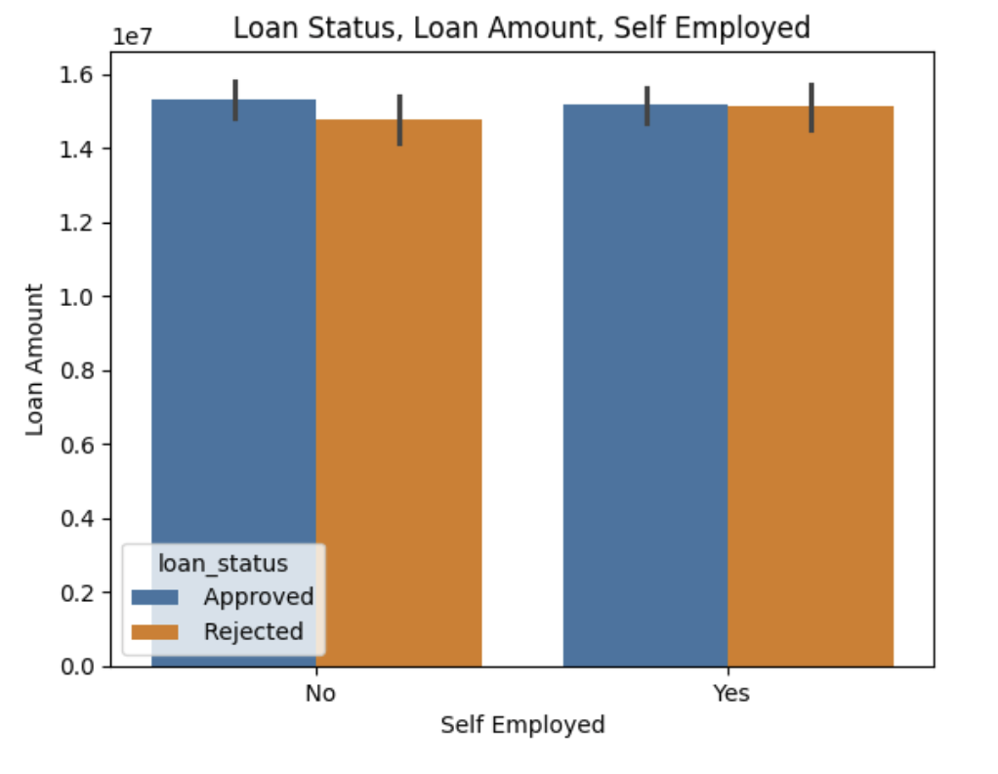
Plots of Education & Self employed
There are no significant differences in loan status for the education & self_employed

Slide 16
SUMMARY
We can say that the features cibil_score(credit score), loan_term , loan _amount, income annum, will help to predict the loan status.
We can also infer from these EDA that all other features like residential assets value, luxury_assets_value, bank asset value, commercial assets_value, no_of_dependents, self_employed and education has least importance in predicting loan status because we saw that these features has no much influence in loan status.
Also, credit score has a great influence in loan approval.

